Slide 1
The Fundamentals of Medication Assisted Treatment
Nick Szubiak, MSW, LCSW
Director, Clinical Excellence in Addictions
National Council for Behavioral Health

Slide 2
Objectives
Understand why and how Medication Assisted Treatment works and why we don't use it by challenging the way we view, judge and think about addiction.
Gain an understanding and recognition of the discrimination and bias that impacts access to evidenced based care for those who need treatment for substance use disorders.
Participants will identify and describe three differences between integrated MAT treatment practices versus non-integrated MAT treatment practices.
Participants will list and describe three common barriers to access MAT and identify strategies to increase access to care.

Slide 3
National Opioid Overdose Epidemic as of 2015
Drug overdose is the leading cause of accidental death in the US, with 52,404 lethal drug overdoses in
Opioid addiction is driving this epidemic, with 20,101 overdose deaths related to prescription pain relievers, and 12,990 overdose deaths related to heroin
From 1999 to 2008, overdose death rates, sales and substance use disorder treatment admissions related to prescription pain relievers increased in parallel.
  overdose death rate in 2008 was nearly four times the 1999 rate;
  sales of prescription pain relievers in 2010 were four times those in 1999;
  substance use disorder treatment admission rate in 2009 was six times the 1999 rate

Slide 4
National Opioid Overdose Epidemic as of 2015
In 2012, 259 million prescriptions were written for opioids, which is more than enough to give every American adult their own bottle of pills.
Four in five new heroin users started out misusing prescription painkillers.
94% of respondents in a 2014 survey of people in treatment for opioid addiction said they chose to use heroin because prescription opioids were “far more expensive and harder to obtain.”

Slide 5
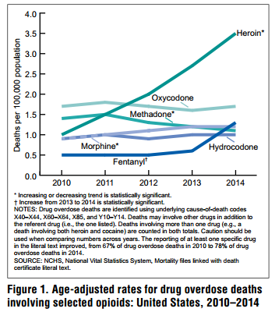
Overdose Deaths
Conclusion: Rising rate of overdose deaths is driven largely by Heroin and Fentanyl
Warner et al. National Vital Statistics Report, 2016;65(10).
Notes:
Source: https://www.cdc.gov/nchs/data/nvsr/nvsr65/nvsr65_10.pdf

Slide 6
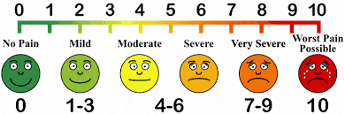
Origins of Opioid Crisis
Opioids Myth: Non-Addictive
  Porter and Jick letter published in New England Journal of Medicine in 1980; frequently cited in marketing of new synthetic opioids
  OxyContin brought to market in 1996
History of Untreated Pain
  Pain was left untreated even for terminally-ill cancer patients
  Doctors were weary of prescribing opioid medications
Pain As 5th vital sign
  National initiative rolled out in the late 90s
Emergence of Pill Mills
  Unrestricted prescribing of pain medications
  Unlike legitimate pain clinics, pill mills see greater numbers of patients, write more prescription, and do less medical exams. Most are cash-only.
Greater availability of heroin
  Larger, cheaper supply and more potent than prescription painkillers
Leading Cause of Accidental Death
  Starting in 2008, drug overdoses became the leading cause of injury death in the United States surpassing car accidents and firearms
Notes:
Availability of Heroin Source 1: http://time.com/4505/heroin-gains-popularity-as-cheap-doses-flood-the-u-s/
Availability of Heroin Source 2: http://www.economist.com/blogs/economist-explains/2014/11/economist-explains-19
Leading Cause of Injury-Related Death: http://www.voanews.com/a/dea-drug-overdoses-are-leading-cause-of-us-injury-deaths/3038150.html

Slide 7

Stigma and Discrimination
Stigma refers to negative stereotypes
Discrimination is the behavior that results from the negative stereotype
Discrimination in this case means treating someone less favorably than someone else because he or she has a disability
  Would you treat someone less favorably because they were prescribed insulin for diabetes? What about people with high-cholesterol who are prescribed cholesterol-lowering medication?
Notes:
It is also discrimination to treat people in MAT differently than people who are prescribed medication to treat other disabilities, such as people prescribed insulin for diabetes or people with high cholesterol who are prescribed cholesterol-lowering medication.

Slide 8


Beliefs Perceptions

Slide 9
How has our definition of addiction changed?
Addiction was thought of as a moral failing or character defect
Drug use: criminal issue vs. health issue
Language matters: move away from “addicts”
  Scientific research has demonstrated that, whether we are aware of it, the use of certain terms implicitly generate biases that can influence the formation and effectiveness of our social and public health policies in addressing them
Notes:
Our choice of language can perpetuate negative public perceptions of individuals who use drugs and alcohol.
Source: John F. Kelly PhD, Richard Saitz MD & Sarah Wakeman MD (2016) Language,
Substance Use Disorders, and Policy: The Need to Reach Consensus on an “Addiction-ary”,
Alcoholism Treatment Quarterly, 34:1, 116-123, DOI: 10.1080/07347324.2016.1113103

Slide 10
Notes:
Remind students not meeting dx criteria does not mean everything is fine. A Positive Screen may not meet diagnostic criteria but could still benefit from a brief intervention.

Slide 11
Three Stages of Addiction
Tolerance
Excessive time spent using/obtaining
Excessive amounts used
Withdrawal
Cravings or urges to use
- Hazardous use
Health problems
Missed obligations
Interference with activities
Personal problems
Unsuccessful attempts to cut down
Notes:
The article explains the evidence for each of the 11 Critera in DSM 5

Slide 12
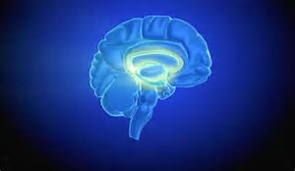
SUD is a complex disease that results in chemical and physiologic changes to the brain
SUD must be treated like any other chronic, relapsing condition
Slide from C. Cynthia Reilly, MS, BS Pharm
Director, Substance Use Prevention and Treatment Initiative
The Pew Charitable Trusts Reily
www.nida.gov
Notes:
It’s outside the scope of this presentation to fully describe the scope of changes that occur in the brain, but a brief overview is important to our discussion. According the National Institute of Drug Abuse, most addictive substances target the brain’s reward system by flooding the circuit with dopamine. Dopamine is a neurotransmitter present in regions of the brain that regulate movement, emotion, cognition, motivation, and feelings of pleasure. The overstimulation of this system, which rewards our natural behaviors, produces the euphoric effects sought by people who use drugs and teaches them to repeat the behavior.
Previously, SUD had been treated with an acute care approach, but public health leaders have been outspoken in transitioning away from this model and recognizing the importance of seeing SUD as a chronic disease.
Surgeon General Vivek Murthy, National Institute on Drug Abuse Director Nora Volkow and others have all been outspoken about the need to treat SUD as a chronic disease
As with all chronic disease the disease may worsen or relapse and require more intensive treatment to bring the disease back in control.
When we view SUD as a chronic disease, there is recognition of the need for consistent and ongoing treatment. Patients with SUD require treatment services over time in order to sustain recovery.

Slide 13
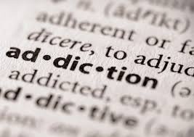
Defining Addiction
Biological
Psychological
Social
Components
Addiction is a primary, chronic
disease
Primary Disease - meaning that it’s not the result of other causes such as emotional or psychiatric problems. Chronic Disease - like cardiovascular disease or diabetes it must be treated, managed and monitored over a life‐time.
Notes:
ASAM definition: http://www.asam.org/quality-practice/definition-of-addiction
Addiction is a disease. – Science indicates and EBPs exist for:
Biological: detox, integrated physical and behavioral healthcare, SBIRT, MAT
Psychological: counseling/psychotherapy such as CBT to help people regulate their thoughts, feelings, and behaviors
Social: Social Model of Recovery – which deploys peer support in practicing new ways of thinking and acting to transition from the culture of addiction to the culture of recovery - (People, places, things)

Slide 14
“At its core, addiction isn’t just a social problem or a moral problem or a criminal problem. It’s a brain problem whose behaviors manifest in all these other areas. “
Many behaviors driven by addiction are real problems and sometimes criminal acts. But the disease is about brains, not drugs. It’s about underlying neurology, not outward actions.”
- Dr. Michael Miller, ASAM

Slide 15
Defining Addiction
Addiction is a primary, chronic and relapsing brain disease characterized by an individual pathologically pursuing reward and/or relief by substance use and other behaviors
- ASAM

Slide 16
Beliefs Perceptions

Slide 17

How has addiction treatment changed?
Short-term acute interventions vs. chronic disease management model
Relapse is a part of the disease, NOT a failure
  Similar to other chronic diseases, addiction often involves cycles of relapse and remission
  Without treatment or engagement in recovery activities, addiction is progressive and can result in disability or premature death

Slide 18

Welcome MAT
Recovery Work
Intensive Psycho, Social and Behavioral treatments
Medications

Slide 19
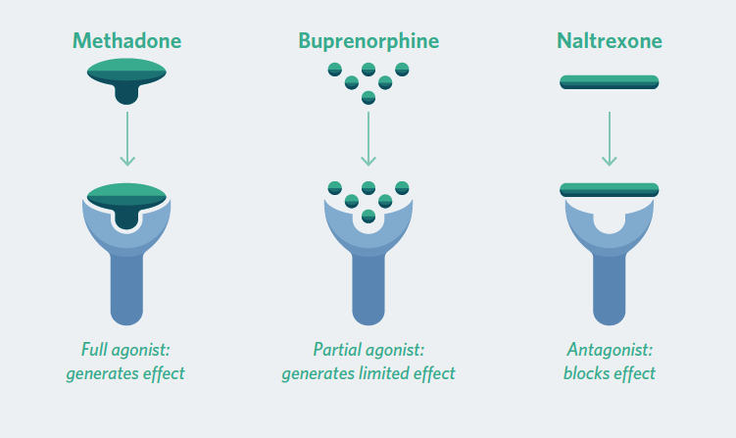
OUD Drugs: Distinct Pharmacology and Roles in Treatment
http://www.pewtrusts.org/en/research-and-analysis/fact-sheets/2016/11/medication-assisted-treatment-improves-outcomes-for-patients-with-opioid-use-disorder
Notes:
This graphic provides more detail on how the three FDA medications work
Methadone is a full agonist. By fully occupying the mu-opioid receptor, methadone lessens the painful symptoms of opiate withdrawal and blocks the euphoric effects of other opioid drugs.
Buprenorphine is a partial agonist, meaning it does not completely bind to the mu-opioid receptor. As a result, buprenorphine has a ceiling effect, meaning that its effects will plateau and will not increase even with repeated dosing.
Naltrexone is an opioid antagonist, meaning that it covers, rather than activates, the mu-opioid receptor, effectively blocking the effects of opioids if they are used.
Guidelines from the American Society of Addiction recommend that prescribers have the ability to prescribe any of these drugs for a patient based on the disease course, past treatment history, and setting of care. We’ll talk more about that later in the presentation.

Slide 20

The Case for MAT
MAT is “the use of medications, in combination with counseling and behavioral therapies, to provide a whole-patient approach to the treatment of substance use disorders.”--SAMHSA
Research indicates that methadone and buprenorphine have a strong evidence base supporting their clinical effectiveness. Strong support for Vivitrol.
MAT is the gold standard for opioid use disorder (OUD) treatment:
  Reduces drug use
  Reduces risk of overdose
  Prevents injection behaviors
  Reduces criminal behavior
Notes:
As our knowledge of addiction advanced, so too did our treatments for addiction
Source for bullet #2: http://adai.uw.edu/pubs/infobriefs/MAT.pdf
Flag Evidence for vivitrol**

Slide 21
MAT Supports Recovery
persistent intentional abstinence from intoxication
engagement in daily life
gaining employment
reestablish family and social ties
being present in everyday life
being able to weather the challenges, daily lows and highs of life without substances as an external coping skills that has negative side effects and consequences

Slide 22

An Unmet Need
20.2 Million People Have SUD
2 million had a substance use disorder involving prescription pain relievers and 591,000 had a substance use disorder involving heroin
10% to 40% of individuals with addictions receive treatment
Only a fraction of those that get treatment get MAT
  300,000-400,000 people on methadone in a given year
  40,000 on buprenorphine
  5-10,000 on Naltrexone
Only 10% of the people who need to be on MAT for opioid use disorder (OUC) are receiving it
More than two-thirds of U.S. clinics and treatment centers still do not offer MAT medications (Stateline, 2016)
Notes:
http://www.pewtrusts.org/en/research-and-analysis/blogs/stateline/2016/12/23/in-drug-epidemic-resistance-to-medication-costs-lives
http://www.pewtrusts.org/en/research-and-analysis/blogs/stateline/2016/01/13/helping-drug-addicted-inmates-break-the-cycle
http://www.jhsph.edu/research/centers-and-institutes/center-for-drug-safety-and-effectiveness/opioid-epidemic-town-hall-2015/2015-prescription-opioid-epidemic-report.pdf
http://www.centeronaddiction.org/addiction-research/reports/substance-abuse-prison-system-2010

Slide 23
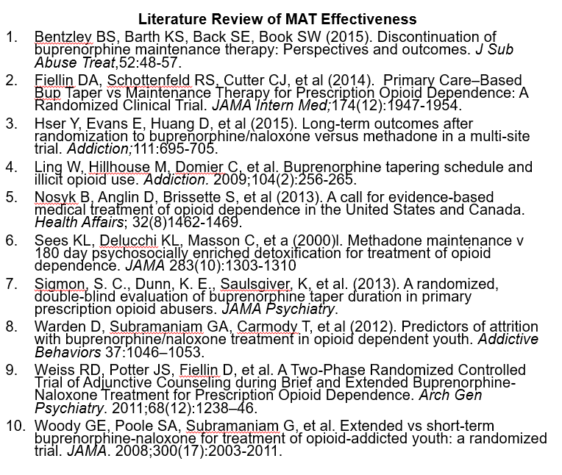
Evidenced Based☺- Utilization☹

Slide 24
The Bias Against MAT
Belief that use of medication conflicts with abstinence-based treatment programs like 12-step programs*
*Not all 12-step programs prohibit MAT and mutual support groups remain an important part of addiction treatment and recovery.
Notes:
Substitution myth: People who believe that MAT is substituting one opioid for another need to understand the difference between physical dependence and addiction. Also, unlike other opioids, methadone and buprenorphine reduce drug cravings and prevent relapse without causing a “high.” Importantly, people on MAT do not suffer impaired cognitive functioning.
*Not all 12-step programs prohibit MAT and mutual support groups remain an important part of addiction treatment and recovery.

Slide 25
The Bias Against MAT
Belief that abstinence is more effective than MAT
  Many people, including individuals who have worked in the treatment field, have recovered from addiction without the use of medications

Slide 26
The Bias Against MAT
Perception that MAT is not treating the underlying causes of addiction.

Slide 27
The Bias Against MAT
Negative perceptions around methadone clinics; patients may try to limit their time there

Slide 28
The Bias Against MAT
Belief that people on MAT are not in recovery; not “clean”

Slide 29
The Bias Against MAT
Belief that MAT is a substitution of one drug for the other; fighting fire with fire

Slide 30
The Bias Against MAT
Belief that opioid use is not in my scope an should be treated by specialty addiction providers

Slide 31
Stopping/Tapering MAT
There is no evidence to support stopping MAT
  95% of methadone patients do not achieve abstinence when attempting to taper off (Nosyk, et al. 2013)
  Over 90% of buprenorphine patients relapse within 8 weeks of taper completion (Weiss, et al. 2011)
Successful patients are commonly maintained on
  Methadone for 24+ months, Buprenorphine for 18+ months
Typically patients with continuous sobriety for 1-2+ years have the best outcomes
  Treatment <6 months has worse outcomes

Slide 32
VERDICT
Bias against MAT is deadly
Leading Cause of Accidental Death
  Starting in 2008, drug overdoses became the leading cause of injury death in the United States surpassing car accidents and firearms

Slide 33
Sound Familiar?
Similar to the 1990s with patients who had suicidal depression and were being judged for taking Prozac

Slide 34

Patient Impact
Neglected a full range of treatment options
Pressure from child welfare, jail, prison, and parole/probation systems to stop MAT
Restricted access to recovery support services
  For example, many recovery houses do not allow residents to be on MAT
The previous two points can lead patients stop MAT before it is clinically appropriate
Notes:
The bias against MAT trickles down to patients’ experiences and other systems that touch addiction such as child welfare, criminal justice, housing, employment, etc.
Child welfare: http://www.nbcnews.com/news/us-news/pregnant-opiates-when-following-doctors-orders-breaks-law-n100781

Slide 35

Biases within MAT
Methadone and buprenorphine are narcotics
  Bias towards using Vivitrol because it is “safer”
Diversion of methadone and buprenorphine
  Used to get “high” and street value
“Addiction doctors agree that all three medications should be available to patients, because one may be more effective than another, depending in part on the person’s age, length of time as an addict ☹, home and work environment and underlying mental health issues. The American Medical Association, the American Academy of Addiction Psychiatry and the American Society of Addiction Medicine unequivocally support their use.” (Stateline, 2016)
Notes:
The fact that methadone and buprenorphine are controlled substances have left some in the criminal justice system to show preference towards naltrexone. Specifically, concern about buprenorphine diversion has led many drug courts to prefer Vivitrol injections for mandated treatment. Although methadone and bup are limited in their ability to cause a high, they nonetheless are sold on the street. Diversion of both methadone and buprenorphine show the need for greater access to medication-assisted treatment.

Slide 36
MAT Methadone Bias
Treating and opioid with an opioid? Fire with Fire?
Overdose trends in the US: Long acting or extended release
Methadone is long acting – stays in your system 24-36 hours but the pain control or analgesia only lasts 6-8 hours
Pain management vs OUD treatment
Talking about pill form vs liquid form
Observed in clinic vs pills taken in the community (diversion)

Slide 37
3 P’s: Providers, Perceptions, Payment
Perceptions: The perceptions of MAT and its value among patients, practitioners, and institutions
  Some practitioners do not believe that MAT is more effective than abstinence-based treatment—when patients are treated without medication—despite science-based evidence
Providers: The availability of qualified practitioners and their capacity to meet patient demand for MAT
  Hiring physicians can be expensive for clinics, especially small centers Physicians receive little education in addiction care & are reluctant to extend their practice to patients with addictions
Payment: The availability and limits of insurance coverage for MAT
  Few private insurers and state Medicaid programs cover all of the MAT medications approved by the Food and Drug Administration. Other face hurdles such as prior authorization requirements or “fail first” policies.
Notes:
Already reviewed Perceptions, let’s talk about the other two Ps that create barriers to MAT.
http://www.pressherald.com/2017/01/08/hurdles-dissuade-doctors-from-providing-suboxone/ (for provider section)

Slide 38

How do we impact discrimination?
Share the evidence!
Recognize MAT for what it is:
The gold standard of OUD treatment

Slide 39
Defining Recovery
A process of change through which individuals improve their health and wellness, live a self-directed life, and strive to reach their full potential.

Slide 40
What is recovery?
A process of change through which individuals improve their health and wellness, live a self-directed life, and strive to reach their full potential.
Health: overcoming or managing one’s disease(s) or symptoms—for example, abstaining from use of alcohol, illicit drugs, and non-prescribed medications if one has an addiction problem—and for everyone in recovery, making informed, healthy choices that support physical and emotional wellbeing.
Home: a stable and safe place to live;
Purpose: meaningful daily activities, such as a job, school, volunteerism, family caretaking, or creative endeavors, and the independence, income and resources to participate in society; and
Community: relationships and social networks that provide support, friendship, love, and hope.
https://blog.samhsa.gov/2012/03/23/defintion-of-recovery-updated/#.WLY7_TvytPY

Slide 41
What is recovery?
Persistent intentional abstinence from intoxication
Engagement in daily life
Gaining employment
Re-establish family and social ties
Being present in everyday life
Being able to weather the challenges, daily lows and highs of life without using substances as an external coping skills that has negative side effects and consequences

Slide 42

Embracing Many Pathways to Recovery
All patients are offered MAT: Methadone, Buprenorphine, Naltrexone
Patient Centered Care: All patients have an option of any of the three medications to treat SUD. There are pros and cons to each. There should be consideration of where they are in life, phase of treatment, and what the patient needs
Treatment works better with patient buy-in
Notes:
Medication-assisted treatment is not the only path to recovery. Creating a recovery-oriented system of care involves providing a menu of traditional treatment services and alternative therapies, including peer recovery coaching, acupuncture, meditation, and music and art therapy. Recovery support services, including employment assistance, child care, care management and housing support, may enhance the engagement of individuals and their families in achieving and sustaining recovery.

Slide 43

The Fundamentals of Medication Assisted Treatment:
An Integrated Approach to Recovery for Individuals with Co-Occurring Disorders
Angele Moss-Baker, LPC, LMFT, MAC, EAS-C
Comprehensive Addiction & Psychological Services, LLC

Slide 44
Traditional Approaches to Treatment
Sequential treatment - The client is treated in one system, then the Agencies work largely independent of each other.
Parallel model – The client is treated simultaneously, but by two separate agencies. The patient participates in two systems simultaneously. Coordination is not consistent.
Notes:
“Research results suggest that sequential treatment (treating one disorder first, then the other) and parallel treatment (treatment for both disorders provided by separate clinicians or teams who do not coordinate services) are not as effective as integrated treatment (Drake, O’Neal, & Wallach, 2008)”.
Treatment approaches that treat a singular disorder without consideration of the impact of a co-occurring disorder(s) are less suited to the special needs of individuals with CODs .” (Rosenthal and Westreich, 1999; Sterling et. al., 2011).

Slide 45
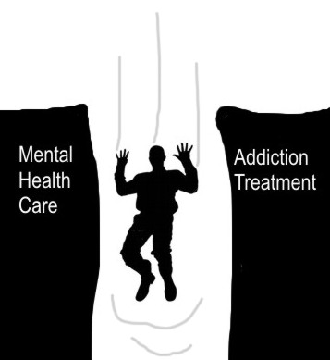
Falling Through the Cracks
Notes:
Many people who are opioid addicted have co-occurring mental disorders. However, the MH and SUD systems often are separated, and the client with co-occurring disorders tend to “fall through the cracks” of the traditional treatment system and develop even worse and more expensive problems.
Many MH facilities and housing programs do not accept clients in MAT, forcing the client to manipulate the system and/or choose which system to enter to access treatment. (JOHN R.)
Without integrated treatment, one or both disorders might not be addressed properly.
The new integrated system effectively serves individuals with co-occurring disorders whether they are seeking help for substance use disorders or mental health conditions.

Slide 46
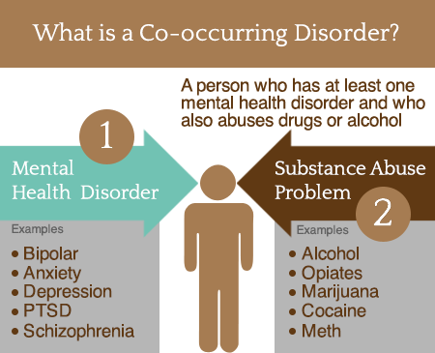
Notes:
Many people who are opioid addicted have co-occurring mental disorders.
Patients in MAT who have co-occurring disorders often exhibit behaviors that interfere with treatment (MY STORY).
Independent Disorders (Primary): continue to occur even when an individual is not using drugs for a sustained period of time, or have an onset before the opioid use disorder.
Substance-induced Disorders (Secondary): all or most of the symptoms are the direct result of substance use.
Need to accurately identify patients with COD to improve MAT outcomes.

Slide 47
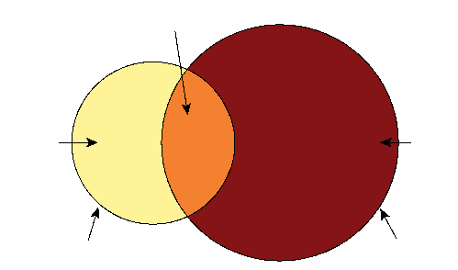
2015: Co-Occurring Mental Health and Substance Use – Adults
SUD and Mental Illness
SUD,
No Mental
Illness
8.1
Million
35.4
Million
Mental Illness,
No SUD
11.5 Million
43.4 Million Had Mental Illness
19.6 Million
Had SUD
Results from 2015 National Survey on Drug Use and Health
Notes:
Aged 12 or Older
In 2015, approximately 20.8 million people aged 12 or older had an SUD
Among the 20.8 million people with a substance use disorder
19.6 million adults with a substance use disorder
Approximately 591,000 had a substance use disorder involving heroin.

Slide 48
Comorbidities and MAT
Psychiatric Comorbidity
  The most common are: Major Depression, Anxiety, Bipolar, PTSD.
  Psychiatric comorbidities may complicate buprenorphine treatment.
  NOTE: Combining medications used in MAT with anxiety treatment medications can be fatal. Benzodiazepines are highly associated with overdose fatalities when combined with opioids.
Medical Comorbidity
  The most common are: HIV, Hepatitis B and C, Tuberculosis, Syphilis.
  MAT and drug interactions - antiretroviral medications, vital hepatitis medical treatment.
Notes:
Relapse rates are high amongst people with co-occurring substance use and mental health disorders, especially those who do not receive integrated care.
Over 40% of opioid dependent individuals have co-occurring psychiatric disorders. The most common are:
depression, anxiety disorders, and bipolar disorder.
Psychiatric comorbidities may complicate buprenorphine treatment in terms of treatment priorities, stabilization concerns, and medication interactions.
To make a sound treatment decision, you need to distinguish between independent and substance-induced disorders using the criteria below:
Independent Disorders (Primary): continue to occur even when an individual is not using drugs for a sustained period of time, or have an onset before the opioid use disorder.
Substance-induced Disorders (Secondary): all or most of the symptoms are the direct result of substance use.
Observe the patient during a period of abstinence from the substance use
Take a thorough history, if possible, talk to family members or friends treat both problems simultaneously. If one disorder is not treated adequately or at all, both can become more severe.
When possible, use medications that treat both disorders (Brady, 2006)

Slide 49

Which Comes First?
Notes:
Discussion:
Some addiction specialist believe that disorders like schizophrenia, depression or anxiety trigger substance abuse, while others believe that durg or alcohol addiction causes mental illness.
In some cases, symptoms of a mental disorder mimic or resemble the symptoms of substance use so closely that even a psychiatrist would find it difficult to tell where on condition or disorder begins and the other ends.

Slide 50
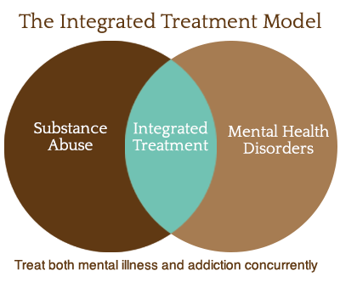

Slide 51

Integrated Treatment
An approach that involves simultaneous treatment of both disorders in a setting designed to accommodate both problems in a unified and comprehensive treatment program.
An approach to meet the substance use, medical and mental health, and social needs of a patient
Notes:
Positive outcomes include:
Reduced substance use
Improvement in psychiatric symptoms and functioning
Decreased hospitalization
Increased housing stability
Fewer arrests
Improved quality of life
.

Slide 52
Essential Principles and Competencies for COD and MAT
Integrated Treatment or highly coordinated when not on site.
  Monitor patient progress and compliance with off-site treatment
Staff competency – Cross training
  Co-occurring psychiatric and medical conditions
Psychotropic medications - prescribed when significant impairment exists.
  Prescribing medications with abuse potential such as benzodiazepines (opt Serax)
  All medications are monitored
Alleviate shame and stigma to receive treatment for co-occurring disorders
Intensive therapy for those with CODs, than those without CODs.
Notes:
The following principles are essential to manage patients with co-occurring disorders in an OTP:
Treatment of co-occurring disorders should be integrated or closely coordinated with substance abuse treatment when the former is not available on site.
Staff members, whether primarily from the substance abuse treatment or mental health fields, should be knowledgeable about treatments for both disorders.
Psychotropic medications should be prescribed only after patients are stabilized on the treatment medication (which in the panel's experience takes an average of 3 to 7 days for buprenorphine and 3 weeks to a month for methadone), unless an independent co-occurring disorder is evident from past records or clinical examination or significant impairment associated with the symptoms of a co-occurring disorder exists.
All medications used by patients and patients' adherence to medication regimens should be monitored carefully, for example, via drug testing. Physicians should be careful about prescribing substances with abuse potential, such as benzodiazepines. If such medications are prescribed, the less abusable drugs in a class should be chosen, for example, oxazepam (Serax®) rather than lorazepam, clonazepam, alprazolam or diazepam.
Patients resistant to being psychiatrically diagnosed should be assured that it is not shameful but is likely to provide a better understanding of their problems and aid in treatment. Educating patients about co-occurring disorders helps.
Therapy for patients with co-occurring disorders should be more intensive, on average, than for patients without co-occurring disorders. The primary goal is abstinence from substances. Remission of co-occurring disorder symptoms should be an important secondary goal.

Slide 53
Quadrants of MH/SUD Services
Category III Substance Abuse System Severe SUD, Mild MI Med-Monitored IPWM, PHP, RTF, MAT DDC/DDE | Category IV Acute Care Hospitals Severe MI, Severe SUD Med-Managed IPWM, IP Psych, Residential
Category I Primary Health Care Mild MI, Mild SUD PCP, OP, IOP | Category II Mental Health System Severe MI, Mild SUD OP, IOP, PHP, ACT, GH
High Intensity
Alcohol and other drugs
Low Intensity
High Intensity
Mental Illness
Notes:
The Four-Quadrant Model: A basic framework for matching disorder severity with appropriate treatment.
Quadrant 1 People with low-severity substance abuse and low-severity mental illness can be treated:
Within the primary healthcare system (such as by your physician).
From either intermediate outpatient addiction treatment or intermediate outpatient mental health programs (some integration of services between mental health and addiction treatment providers)
Quadrant 2 People with serious mental illness and milder substance use disorders can access the mental health system through :
Outpatient mental health centers (such as clinics) or
More intensive residential or inpatient programs. Many mental health providers will also offer some addiction treatment, such as motivational interviewing or skills training.
Quadrant 3 Care - DDC and DDE Programs
People with more serious substance use disorders and less serious mental health disorders should receive substance abuse treatment as the primary focus of care.
Programs designed for people needing co-occurring disorder services are called dual diagnosis capable (DDC) and dual diagnosis enhanced (DDE) programs.
DDC Programs – These programs address the interaction between mental disorders and SUD. DDC programs offer treatment integration needs of clients with co-occurring disorders. DDE Programs –DDE programs offer a higher level of treatment integration for those who have more serious mental health disorder symptoms or functional impairment.
Quadrant 4Patients presenting with suicidal or homicidal ideation or threats, or those manifesting psychotic symptoms that may interfere with their safety and ability to function. Immediate administration of antipsychotic drugs, benzodiazepines, or other sedatives may be required to establish behavioral control. A physician, physician's assistant, or nurse practitioner on staff can prescribe medications at the OTP.

Slide 54
ASAM Treatment Levels of Service
Level III Med-Monitored IPWM Clinically-Managed Residential WM Medically-Monitored Intensive Inpatient Clinically-Managed High-Intensity Residential Clinically Managed Population-Specific High Intensity Residential Services Clinically-Managed Low-Intensity Residential | Level IV Med-Managed IPWM Medically-Managed Intensive Inpatient
Level I Ambulatory Withdrawal Management without Extended On-Site Monitoring Outpatient Services Level 0.5 Early Intervention | Level II Ambulatory WM with Extended On-Site Monitoring Partial Hospitalization Intensive Outpatient
OPIOID TREATMENT SERVICES (OTS) | Opioid Treatment Program (OTP) – Agonist meds: methadone, buprenorphine; Office Based Opioid Treatment (OBOT) Antagonist medication – naltrexone
Notes:
Level 1WM - Ambulatory Withdrawal Management without Extended On-Site MonitoringMild withdrawal with daily or less than daily outpatient supervision; likely to complete withdrawal management and to continue treatment or recovery.
Level 2 WM -Ambulatory Withdrawal Management with Extended On-Site Monitoring. Moderate withdrawal with all day WM support and supervision; at night, has supportive family or living situation; likely to complete WM. 3.2
Level 3.2 WM - Clinically Managed Residential Withdrawal Management. Moderate withdrawal, but needs 24-hour support to complete WM and increase likelihood of continuing treatment or recovery.
Level 3.7 WM - Medically-Monitored Inpatient Withdrawal Management. Severe withdrawal and needs 24-hour nursing care and physician visits as necessary; unlikely to complete WM without medical, nursing monitoring.
Level 4 WM - Medically-Managed Inpatient Withdrawal Management. Severe, unstable withdrawal and needs 24-hour nursing care and daily physician visits to modify WM regimen and manage medical instability.
Level 0.5 Early Intervention - Assessment and education for at risk individuals who do not meet diagnostic criteria for Substance-Related Disorder
Level 1 Outpatient Services - Less than 9 hours of service/week (adults); less than 6 hours/week (adolescents) for recovery or motivational enhancement therapies/ strategies
Level 2.1 Intensive Outpatient - 9 or more hours of service/week (adults); 6 or more hours/week (adolescents) to treat multidimensional instability
Level 2.5 Partial Hospitalization - 20 or more hours of service/week for multidimensional instability not requiring 24 hour care
Level 3.1 Clinically-Managed Low-Intensity Residential - 24 hour structure with available trained personnel; at least 5 hours of clinical service/week
Level 3.3 Clinically Managed Population-Specific High Intensity Residential Services (Adult criteria only) - 24 hour care with trained counselors to stabilize multidimensional imminent danger. Less intense milieu and group treatment for those with cognitive or other impairments unable to use full active milieu or therapeutic community
Level 3.5 Clinically-Managed High-Intensity Residential - 24 hour care with trained counselors to stabilize multidimensional imminent danger and prepare for outpatient treatment. Able to tolerate and use full active milieu or therapeutic community
Level 3.7 Medically-Monitored Intensive Inpatient - 24 hour nursing care with physician availability for significant problems in Dimensions 1, 2 or 3. Sixteen hour/day counselor ability
Level 4 Medically-Managed Intensive Inpatient - 24 hour nursing care and daily physician care for severe, unstable problems in Dimensions 1, 2 or 3. Counseling available to engage patient in treatment
Opioid Treatment Services OTS - Opioid Treatment Program (OTP) – agonist meds: methadone, buprenorphine; Office Based Opioid Treatment (OBOT); antagonist medication – naltrexone

Slide 55
ASAM Practice Guideline for the Treatment of Co-Occurring Psychiatric Disorders
A comprehensive assessment including determination of mental health status should evaluate whether the patient is stable.
  Patients with suicidal or homicidal ideation should be referred immediately for treatment and possibly hospitalization.
  Reduce, manage, and monitor suicide risk
Management of patients at risk for suicide should include:
  reducing immediate risk
  managing underlying factors associated with suicidal intent
  monitoring and follow-up
Assessment for psychiatric disorder should occur at the onset of agonist or antagonist treatment.
  Reassessment using a detailed mental status examination should occur after stabilization with methadone, buprenorphine or naltrexone.
Pharmacotherapy in conjunction with psychosocial treatment should be considered for patients with opioid use disorder and a co-occurring psychiatric disorder.

Slide 56
Quadrant of Care:
Where Does Treatment Begin?
Patients in acute psychiatric danger –
Patients presenting with suicidal or homicidal ideation or threats, that may interfere with their safety and ability to function should be assessed and treated immediately whether resulting from:
    acute intoxication or withdrawal, or
    an independent co-occurring disorder or substance-induced disorder
Although their symptoms may be short lived, admission to a psychiatric unit for brief treatment may be necessary if outpatient care is too risky or problematic.
Immediate administration of antipsychotic drugs, benzodiazepines, or other sedatives may be required to establish behavioral control.
A physician, physician's assistant, or nurse practitioner on staff can prescribe medications at the OTP.
Notes:
Patients in acute psychiatric danger - Although their symptoms may be short lived, admission to a psychiatric unit for brief treatment may be necessary if outpatient care is too risky or problematic. Immediate administration of antipsychotic drugs, benzodiazepines, or other sedatives may be required to establish behavioral control. A physician, physician's assistant, or nurse practitioner on staff can prescribe medications at the OTP.

Slide 57
Quadrant of Care:
Where Does Treatment Begin?
Patients with established severe co-occurring disorders who are not in acute danger
Should receive medication with the lowest abuse potential for their condition.
If an OTP is staffed appropriately and prepared to treat patients with severe co-occurring disorders, these patients can be treated on site.
If there is no such OTP, patients may need to remain in a less optimal OTP but receive psychiatric treatment at another facility with effective highly collaborative communication between OTPs and mental health providers to coordinate treatment.

Slide 58
Quadrant of Care:
Where Does Treatment Begin?
Patients with less severe, persisting or emerging symptoms of co-occurring disorders.
Patients in MAT with non-disabling symptoms of less severe co-occurring disorders (e.g., mood, anxiety, and personality disorders) should continue or begin medication, psychotherapy, or both for their co-occurring disorders.
These patients should continue in MAT if the OTP is staffed to treat them.

Slide 59
Quadrant of Care:
Where Does Treatment Begin?
Patients with less severe, presumptively substance-induced co-occurring disorders.
Patients in MAT with symptoms of a psychiatric disorder, without a history of CODs, receive no new psychotropic medications until they are stabilized on MAT - because their symptoms might remit or significantly diminish after a period of substance abuse treatment.
Exceptions include patients who have acute, substance-induced disorders such as extreme anxiety or paranoia that are likely to be transitory but require temporary sedation or antianxiety medication.

Slide 60
Effective Integrated Service Delivery
Based on principles of effective integrated service delivery:
Collaboration and Coordinated Care
  42 CFR § 2 - CONFIDENTIALITY OF SUBSTANCE USE DISORDER PATIENT RECORDS
Motivational Interviewing
Stage-Wise Treatment
Notes:
Motivates and supports a range of positive treatment behaviors and outcomes in patients.
Treatment strategies employ ongoing indicators of clinical response used to adjust both the amount and scope of clinical services over time to.
Prescribing more services for patients with partial and poor responses and less services for those doing well.
COLLABORATION AND COORDINATED CARE
The OTP links primary care, psychiatric, and other office-based providers.
Coordinating with Primary Care - patients frequently have multiple chronic somatic health problems that are ignored or poorly managed. Successful treatment of substance use reduces the risk of contracting, and can slow the progression of, addiction-related medical diseases such as hepatitis and HIV. Adherence to medical treatments is improved when substance use declines.
Coordinating with Psychiatric Providers - fully integrated (e.g., co-located) psychiatric evaluation and treatment within the OTP is ideal

Slide 61
Effective Integrated Service Delivery
Collaboration/Coordinated
Care
Motivational
Interviewing
Stage-Wise
Treatment
With Psychiatric Providers
With MAT Physician
With Primary Care and other medical providers
Coordinating with Specialty Providers
Empathic
Nonjudgmental
Roll with Resistance
Precontemplation
Contemplation
Preparation
Action
Maintenance
Notes:
Engagement Stage of Treatment (Precontemplation)
Reduce acute symptoms of mental disorders
Facilitate therapeutic alliance
Persuasion Stage of Treatment (Contemplation & Preparation)
Stabilize and decrease psychiatric symptoms
Avoid meds that may be addictive
Active Treatment (Action SOC)
Stabilize and manage psychiatric symptoms
Medication Assisted Treatment
Avoid meds that may be addictive
Relapse Prevention (Maintenance SOC)
Reduce risk of relapse of symptoms of both disorders
Avoid meds that may be addictive

Slide 62
References
Medication Assisted Treatment: A Standard of Care. Elinore McCance-Katz, SAMHSA 2014.
A Family Guide to Concurrent Disorders. Centre for Addiction and Mental Health.
Integrated Service Delivery Models for Opioid Treatment Programs in an Era of Increasing Opioid Addiction, Health Reform, and Parity. Kenneth B. Stoller, Mary Ann C. Stephens, Allegra Schorr. American Association for the Treatment of Opioid Dependence, July 2015.
Medication-Assisted Treatment for Opioid Addiction in Opioid Treatment Programs: TIP 43. SAMHSA 2012.
Federal Guidelines for Opioid Treatment Programs. SAMHSA January 2015.
The ASAM National Practice Guideline For the Use of Medications in the Treatment of Addiction Involving Opioid Use. American Society of Addiction Medicine. (2013). The ASAM Criteria: Treatment Criteria for Addictive, Substance-Related, and Co-occurring Conditions

Slide 63
Thank You!
Angele Moss-Baker
Comprehensive Addiction & Psychological Services, LLC
Caps.therapy@yahoo.com
www.caps-therapy.com

Slide 64

Policy Interventions
Affordable Care Act/Medicaid expansion
  Individuals with mental health and substance use disorders were the single largest beneficiaries of Medicaid expansion with nearly one-third of new Medicaid enrollees having a either a mental health and/or Substance Use Disorder
Physician Buprenorphine Prescribing Limit Raised to 275 Patients
  June 2016 SAMHSA raised doctor prescribing limit from 100 to 275 patients
Comprehensive Addiction & Recovery Act (CARA)
  Allows Nurse Practitioners and Physician Assistants to prescribe buprenorphine for up to 30 patients
  First addiction bill passed through Congress in 40 years
21st Century Cures Act
  Allocated $1 billion in State Targeted Response grants to curb opioid abuse and increase treatment capacity
Surgeon General Report
  First Surgeon General report on addiction

Slide 65
Resources on Opioid Use
Centers for Disease Control and Prevention
  Overdose Data
  Guidelines for Prescribing Opioids for Chronic Pain
Substance Abuse and Mental Health Services Agency
  Data on Prescription Opioid and Heroin Use from the annual National Survey on Drug Use and Health
  Medication-Assisted Treatment
    Information on certification, oversight, DATA-2000 waivers, legislation, regulation, and more
Office on National Drug Control Policy (archived website)
    National Drug Control Strategy
    Data on Methadone, Buprenorphine treatment and drug poisoning deaths
National Institutes on Drug Abuse
    Opioid Epidemic Strategies & Resources

Slide 66
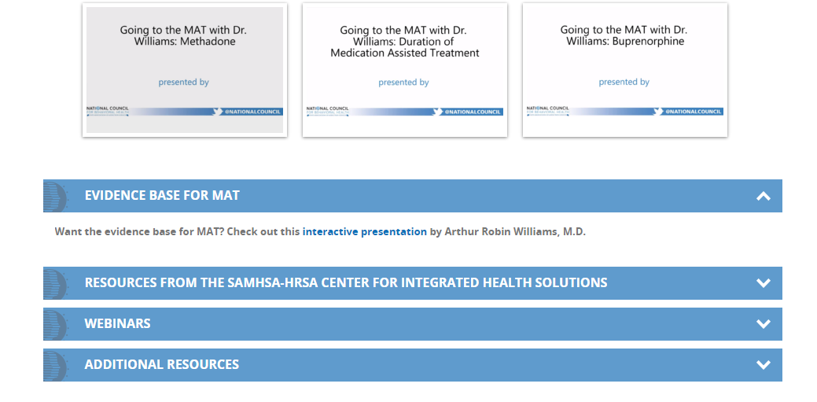
https://www.thenationalcouncil.org/mat/

Slide 67

PCSS-MAT is a collaborative effort led by American Academy of Addiction Psychiatry in partnership with: American Osteopathic Academy of Addiction Medicine, American Psychiatric Association, American Society of Addiction Medicine and Association for Medical Education and Research in Substance Abuse.
For more information visit: www.pcssmat.org
For questions email: pcssmat@aaap.org
Twitter: @PCSSProjects
Funding for this initiative was made possible (in part) by Providers’ Clinical Support System for Medication Assisted Treatment (grant no. 5U79TI024697) from SAMHSA. The views expressed in written conference materials or publications and by speakers and moderators do not necessarily reflect the official policies of the Department of Health and Human Services; nor does mention of trade names, commercial practices, or organizations imply endorsement by the U.S. Government.

Slide 68


Treatment Works, People Recover
Research shows that the earlier drug use begins, the more likely it will progress to addiction | Teen alcohol and drug use is declining
More and more individuals are engaged in MAT
Over 23 million Americans are in recovery from addiction to alcohol and other drugs
Notes:
Declining Teen Drug Use is documented in NIDA’s Monitoring the Future Survey, see 2016 numbers: https://www.drugabuse.gov/publications/drugfacts/monitoring-future-survey-high-school-youth-trends

Slide 69
References
1 National Institute on Drug Abuse. (2015). Drugs of Abuse: Opioids. Bethesda, MD: National Institute on Drug Abuse. Available at http://www.drugabuse.gov/drugs-abuse/opioids.
2 American Society of Addiction Medicine. (2011). Public Policy Statement: Definition of Addiction. Chevy Chase, MD: American Society of Addiction Medicine. Available at http://www.asam.org/docs/publicypolicy-statements/1definition_of_addiction_long_4-11.pdf?sfvrsn=2.
3 Center for Behavioral Health Statistics and Quality. (2016). Key substance use and mental health indicators in the United States: Results from the 2015 National Survey on Drug Use and Health (HHS Publication No. SMA 16-4984, NSDUH Series H-51). Retrieved from http://www.samhsa.gov/data/.
4 National Institute on Drug Abuse. (2014). Drug Facts: Heroin. Bethesda, MD: National Institute on Drug Abuse. Available at http://www.drugabuse.gov/publications/drugfacts/heroin.
5 Rudd RA, Seth P, David F, Scholl L. Increases in Drug and Opioid-Involved Overdose Deaths — United States, 2010–2015. MMWR Morb Mortal Wkly Rep 2016;65:1445–1452. DOI: http://dx.doi.org/10.15585/mmwr.mm655051e1

Slide 70

Thank You!
Nick Szubiak, MSW, LCSW
Integrated Health Consultant
Director, Clinical Excellence in Addictions
National Council for Behavioral Health
LinkedIn: Nick Szubiak, MSW,LCSW
Twitter: @nszubiak
nicks@thenationalcouncil.org
Office 202.621.1625 C. 808.895.7679

