Slide 1
Welcome to Mental Health America
Paul Gionfriddo, President and CEO
MHA Annual Meeting Opening, September 2014

Slide 2
Prevention
Integrated Care and Treatment
Recovery
Early Identification and Intervention

Slide 3
What’s Coming Up?
Through the Lens of MHA’s Vision

Slide 4
U.S. Surgeon General
In the United States, mental disorders collectively account for more than 15 percent of the overall burden of disease from all causes and slightly more than the burden associated with all forms of cancer. These data underscore the importance and urgency of treating and preventing mental disorders and promoting mental health in our society.
U.S. Surgeon General’s Report, 1999, page 1

Slide 5
Prevention
Preventable risk factors for mental illnesses – LA Times, 1990
48% of schizophrenia, bipolar patients suffered trauma. (Alvarez, 2011)
Children experiencing 4 types of trauma are 30% more likely to have behavioral and learning problems. (Carrion, 2011)

Slide 6
Early Identification

Slide 7
Early Intervention
Only 1 in 25 with ED is Identified with ED

Slide 8
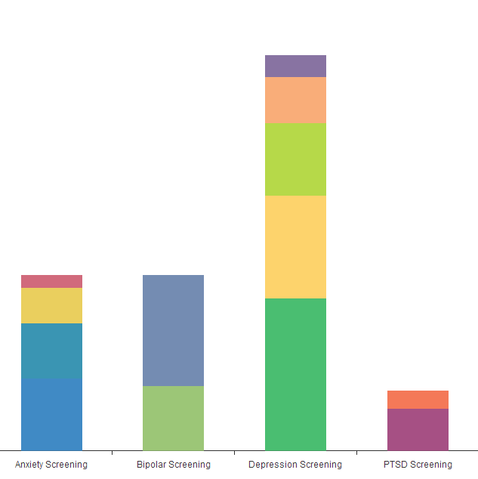
Early Identification:
MHA SCREENING
Minimal
Mild
Moderate
Minimal
Moderately
Severe
Mild
Negative
Moderate
Severe
Negative
Severe
Positive
Positive

Slide 9
Does Income Inequality Matter?

Slide 10
Integrating Care: People with Mental Illness Receive Less Treatment
Source: NIMH

Slide 11
Primary Care and Mental Health

Slide 12
Integrating Care
The Obamacare Effect

Slide 13
What Was Supposed to Happen in Every State: ACA 2016
Source Note: Pie slices derived from RAND analysis published in Health Affairs, June 2013

Slide 14
What Will Happen in Non-Expansion States: ACA 2016
Source Note: Pie slices derived from RAND analysis published in Health Affairs, June 2013

Slide 15
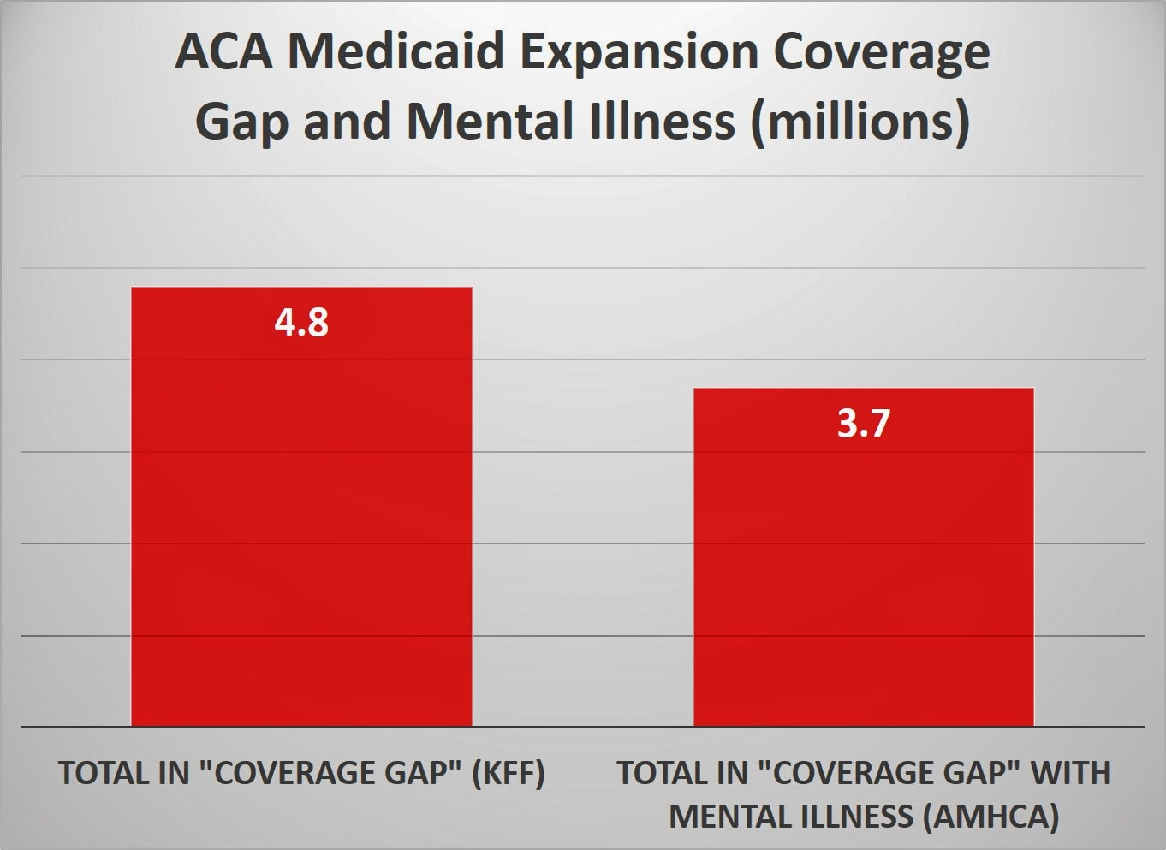
Who’s in the ACA Coverage Gap?

Slide 16
Post-ACA Inpatient MH Admissions Will Increase More
Source: NBER, Antwi, et al, June 2014

Slide 17
…But Payments for Mood Disorders are Low

Slide 18
…And People are Frequently Re-admitted

Slide 19
To Integrate Care, Providers form Accountable Care Organizations (ACOs)
Source: Health Affairs, 1/2014

Slide 20

But integrating care won’t work without parity, too.

Slide 21
Recovery
Mood disorders ranking by age group as principle inpatient diagnosis:
Age 1-17 #1
Age 18-44 #3
Note: 4 of top 5 related to delivery
Age 45-64 #5
Note: top four related to aging
Source: “Most Frequent Conditions in US Hospitals, 2010,” AHRQ, January 2013

Slide 22
Why Recovery Is A Goal
A process of change through which individuals improve their health and wellness, live a self-directed life, and strive to reach their full potential. (SAMHSA, 2011)
Peers, family, providers, treatment, drug therapies, nutrition, exercise, counseling, etc., all play a role in supporting recovery.

Slide 23
NIMH RA1SE
Recovery After Initial Schizophrenia Episode (RA1SE).
Field Research.
Coordinated and aggressive treatment.
Reduce the likelihood of long term disability related to schizophrenia.

Slide 24
WE CAN MAKE A DIFFERENCE
Why MHA Matters

Slide 25
Our Affiliates are the Most Innovative in the Nation
Be Merge – MHA of Palm Beach County
BOSS (Back Office Support Services) – MHA of Middle Tennessee
Check Your Head – MHA of Colorado
FERC (Family Education and Resource Center) – MHA of Alameda County (CA)
I.C. Hope – MHA of Middle Tennessee
Mental Health 101 – MHA of East Tennessee
Peer Place – MHA of Palm Beach County
Peer Recovery Call Center – MHA of East Tennessee
Project Healthy Moms – MHA of Georgia
Respect Institute – MHA of Georgia
Stop the Crazy Talk – MHA of Franklin County (OH)
Texas Youth Suicide Prevention Initiative – MHA of Texas
Youth Screen – MHA of Illinois

Slide 26
Social Media Reach

Slide 27
Social Media Reach

Slide 28
Social Media Reach

Slide 29
Social Media Reach

Slide 30

What Do People Need from Us?

Slide 31
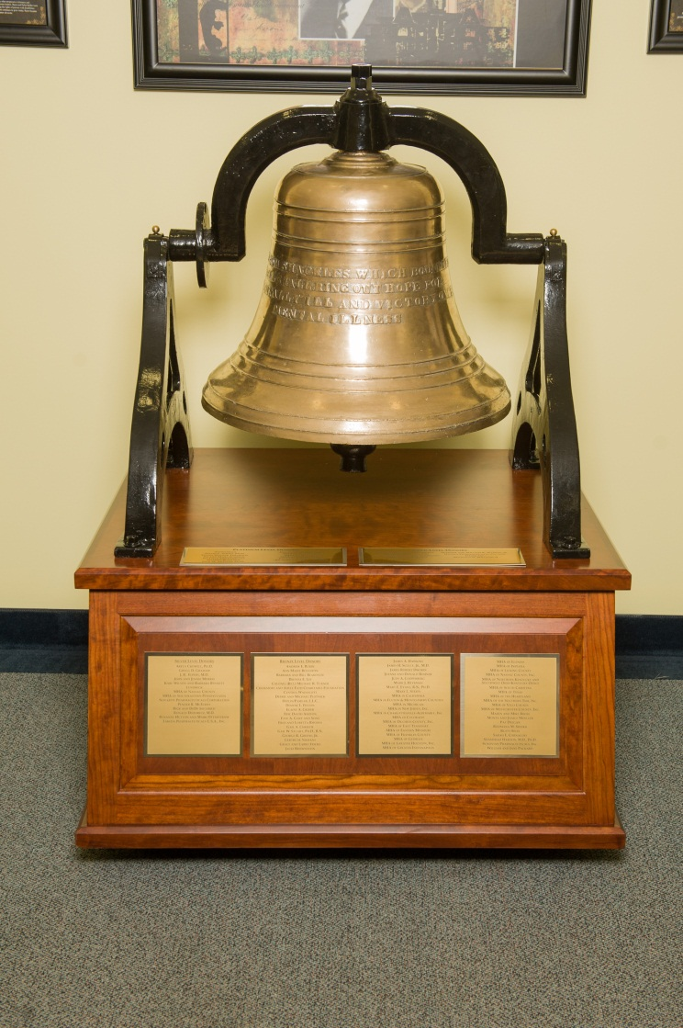

Slide 32
Mental health conditions are the only chronic conditions that as a matter of public policy we wait until Stage 4 to treat, and then often only through incarceration.

Slide 33
#B4Stage4

Slide 34
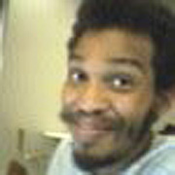
What’s the Alternative?
Source: Steadman et al, 2009

Slide 35
What’s the Alternative?

Slide 36
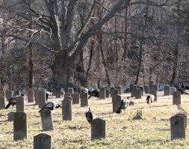

What’s the Alternative?

Slide 37
THANK YOU And Enjoy the Meeting.

