Slide 1

Funding for Peer and
Crisis Services in Managed Behavioral Health
Lori Szczygiel
Senior Vice President, Strategy & Development
Dr. Lawrence Goldman
Senior Vice President, Government Relations
February 19, 2016

Slide 2
Agenda
Introductions
History of Beacon Health Options
Key Funding Solutions
  Fee for Service
  Value Based Payments
Peer Services
  Models
  Compensation
  Payment

Slide 3
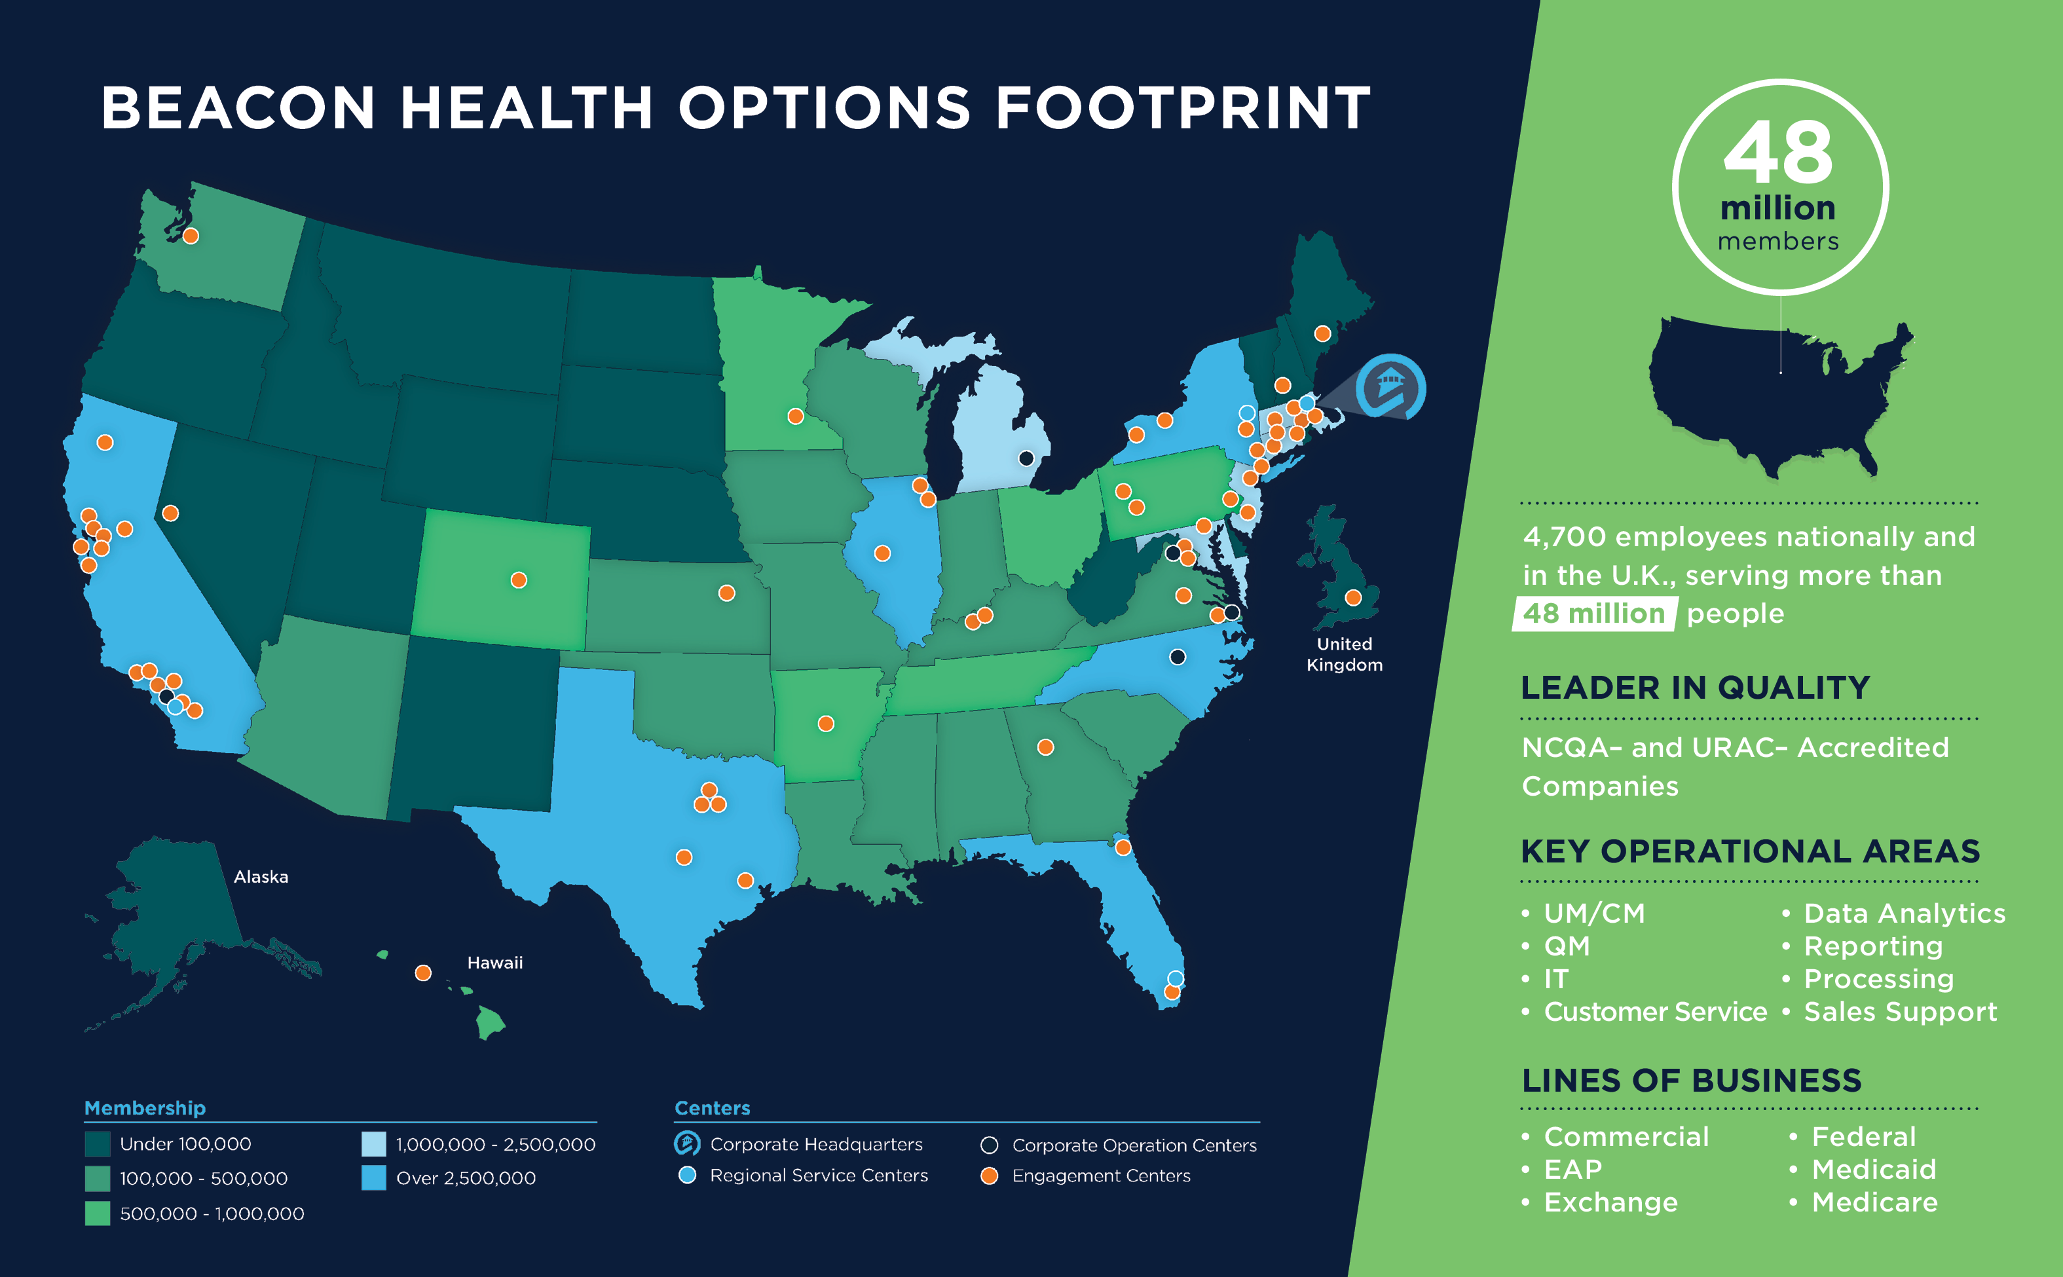
Beacon’s National Scope

Slide 4

About Beacon Health Options
Headquartered in Boston; more than 70 US locations and a London office
225 employer clients, including 45 Fortune 500 companies
Partnerships with more than 95 health plans
Leader serving dual-eligible beneficiaries in six states
Programs serving Medicaid recipients in 26 states and the District of Columbia
Serving 8.6 million military personnel, federal civilians and their families
Accreditation by both URAC and NCQA

Slide 5








Nation’s Largest Behavioral Health Company
Line of Business | Highlights | Sample Client Base
Medicaid Health Plan | 55+ health plan partners in 19 states Largest MBHO in Managed Medicaid 9M+ covered lives
State and County Direct | 5M+ covered lives 30+ direct to State/County Medicaid programs Local engagement centers Certified Peer Support Specialists TANF, ABD, Expansion, SMI, Foster Care populations
Federal Government & Military | TRICARE since 1988 (CHAMPUS) serving 3M beneficiaries Military OneSource EAP serving 5.5M active duty, Guard/Reservist service members & their families Expanded EAP services for the U.S. Coast Guard
✓
✓
✓

Slide 6

















Nation’s Largest Behavioral Health Company (continued)
Line of Business | Highlights | Sample Client Base
Medicare | 16+ years of experience 2M+ covered lives NCQA accredited Partnered with top ranked Quality/HEDIS plans
Commercial | 25+ health plan partners 11M covered lives >1M exchange covered lives 17+ yrs. risk partner 100% contract renewal rate Largest payer of Autism services
Employer/ EAP | 225 employer clients, 14M lives 45+ Fortune 500 clients Employer direct & private exchange Large and small groups EAP and MHSA
✓
✓
✓

Slide 7
Key Funding Solutions

Slide 8
Payment Methodologies
Social Supports
Fee-for-service
One service
One payment
Behavioral Health Outpatient Services
Case Rate
Group of services
Combined payment
Monthly/weekly payment
Care Management
Episode Bundle
Group of services
Combined payment
Quality goals
Defined time period
Behavioral Health
Diversion
Behavioral Health
Inpatient
Total Health Outcomes
Shared risk on total member experience
Behavioral Health Capitation
Risk for providers
Full behavioral health payment
Defined coverage set
Medical Outcomes

Slide 9



Transactional Relationship Model is Reinforced by
Fee-for-Service Reimbursement
Barriers to Alternative Payment Methodologies
Payer
Provider
Government
Consumer
Provider
“WE’VE ALWAYS DONE IT THIS WAY”
Notes:
There are logical reasons why Fee-for-Service is the predominant reimbursement for behavioral health
Diagnosis only tells a portion of the situation, but not the full story
Symptoms matter
Social supports matter
Very few naturally occurring vertically integrated systems of care
Most providers one or only few services
Most providers lack the geographic or financial scale to engender alternative payments methodologies
Many services are directly provided by governments, which limits opportunity for collaboration
Attribution models are tricky because of the fragmented nature of providers and lack of integration between physical health providers and

Slide 10
Alternative Payment Models Currently Used in
Several Markets
Outpatient Case Rates with Quality Incentive (Texas)
  Treatment variability, minimal MCO pre-authorization and encouraged member movement along treatment continuum
  Incentive targets include: OP visits with 7 days of discharge, time in community standard, completion of 340B integrated care assessments
  Providers must accept all patients and submit encounters equal to 90-95% of case rates received
  Case rate is significantly discounted for growth above 3-5% and are prepaid on monthly basis
Inpatient Case Rates (New York)
  Case rate developed with each provider; is some cases-separate rate for adults v. children
  Incorporates targeted LOS and reimbursement rates
  No additional payment if readmission occurs within 30 days of original stay
  May be reduced if target population contains certain higher end diagnosis
Modified Block Grant (Kansas)
  Each provider negotiates annual maximum budget target and are reimbursed on FFS basis up to this target
  Providers must agree to “no eject/no reject” provisions
  Per state’s discretion, additional payments can be made to providers who rendered services in excess of budget target

Slide 11
Alternative Payment Models (continued)
Provider Partner Sub Cap (Colorado)
  Full risk “down stream” (CMHCs)
  BHO manages care rendered by external providers
  Recipients must encounter 90-95% of capitation (maintenance of effort)
  CMHC’s equity holder and board member of CMHC
Risk Pool (Massachusetts)
  Providers can achieve additional earnings if certain targets are met
  Pools limited to specific dollar amounts and target specific levels of care
Provider Sub-Cap (New Hampshire)
  Partial risk down streamed to key CMHC’s
  BHO managed care rendered by external providers
  Recipients must encounter 90% of payment received (maintenance of effort)
  Escalating annual quality withholds tied to achievement of specific measures; hospital remittance, follow-up after hospitalization, care planning.

Slide 12

Massachusetts Emergency
Service Program (ESP)
Provides behavioral health crisis assessment, intervention, and stabilization services (24/7/365) to individuals of all ages who are experiencing a behavioral health crisis.
  Onsite, face-to-face therapeutic response including short term solution focused counseling
  Psychiatric consultation and urgent psychopharmacology intervention, as needed
  Referrals and linkages to all medically necessary behavioral health services and supports, including access to appropriate services along the behavioral health continuum of care

Slide 13
Emergency Services Program
The purpose of the ESP is to:
Respond rapidly
Assess effectively
Deliver a course of treatment
Promote recovery, ensure safety, and stabilize the crisis
Facilitate access to other levels of care
Offer community-based behavioral health emergency services in order to bring treatment to members in crisis, allow for member choice, and offer medically necessary services in the least restrictive environment that is most conducive to stabilization and recovery

Slide 14
Recovery-Oriented Services
  ESPs support resiliency, rehabilitation, and recovery by integrating mental health, substance use disorders, and co-occurring rehabilitation and recovery principles and practices throughout the service delivery model and implementing specific recovery-oriented services, including:
      Certified Peer Specialists
      Family Partners
      Relationships with recovery-oriented and consumer-operated resources

Slide 15
Funding Model for ESP
Beacon receives payment on a capitated basis for the Medicaid population and budget funded for uninsured population
Crisis services under the regional ESP model are paid on a fee for service basis
Most regions are non-profit entities, while the southeastern portion of the state is covered by state employees
New models for service delivery and payment are being considered

Slide 16
Other State Examples
Texas
  Sub-capitation for 23 hour crisis program
  Allows facility to be open 24/7
  Guaranteed monthly cash flow
  Incentive to find alternative treatment and diversion
Kansas
  Block funding to purchase capacity
  24/7 – Firehouse model
Maryland
    Mobile crisis and stabilization & Crisis Assessment - Medicaid funded via a waiver for Children & Adolescents
    Child & Adolescent Response System- Medicaid
    Residential crisis – State funded
    Other county funded services, including Mobile Teams

Slide 17
Value-Based Payments for Crisis Services
Define beginning and end
Ensure capacity to serve all
Track encounters
Build capacity – 24/7 is key
Define quality measures and data points
Measure key parameters – diversion, etc.
Reporting

Slide 18
Peer Services

Slide 19
Peer Services
Impact and importance
Wages and compensation for peers
Reimbursements
  Medicaid
  Federal
  Private
How to build on the impact of these services

Slide 20
The Value of Peer Services
“…Peer support services are an evidence-based mental health model of care which consists of a qualified peer support provider who assists individuals with their recovery from mental illness and substance use disorders. CMS recognizes that the experiences of peer support providers, as consumers of mental health and substance use services, can be an important component in a State’s delivery of effective treatment…” *
* - CMS letter written by Dennis Smith, August 15, 2007

Slide 21
Wages and Compensation
Need wage scale that allows individuals to sustain their independence
Wages need to include benefits and allow for individuals to maintain independence and quality of life
Pay inequities need to be addressed (as with other workers)
  Including employer type of organization
  Geographic region

Slide 22
Peer Reimbursement
“…As health systems…evolve and focus on…outcomes and value based reimbursement systems, …attention will be required to understand how peer…wages should be established…”
* - Daniels, A.S., Ashenden, P., Goodale, L., Stevens, T. National Survey of Compensation Among Peer Support Specialists. The College for Behavioral Health Leadership, www.acmha.org, January 2016

Slide 23
Funding Models for Peer Services
Medicaid
  In 1999, Georgia became the first state to get federal approval to pay for peer services through Medicaid.
  By 2007, Centers for Medicare and Medicaid Services (CMS) urged other states to follow Georgia's lead.
  At least 30 states and the District of Columbia have launched peer programs.
  New emphasis on whole health coaching as a reimbursable service (e.g. Whole Health Action Management – WHAM)

Slide 24
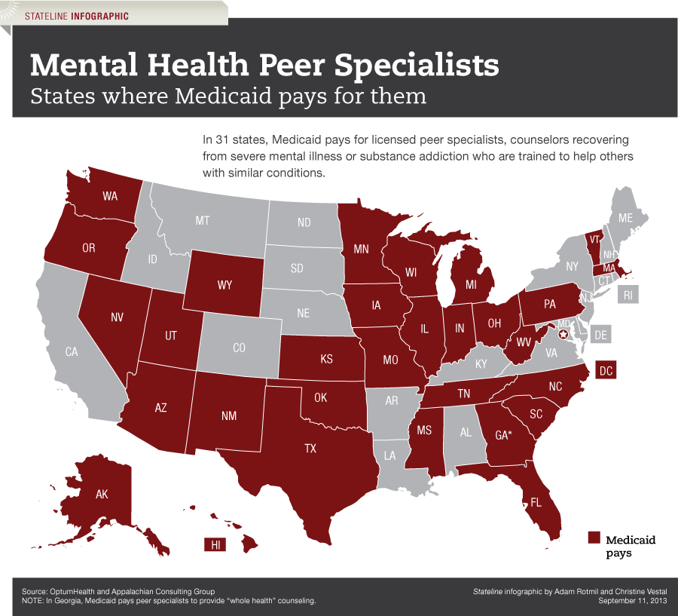
States Where Medicaid Pays for Peer Services

Slide 25
A Look at the Future
Expand services that can be delivered by Peers
  Forensic (Pennsylvania model)
  Whole health
  Add reimbursement in more states
  Work with private payers, not just government
Focus on recovery that is measurable
  Create new payment models based upon impact
  Look at creativity in the model
      Currently outcomes typically measured are clinical
      Evaluate additional outcomes specific to peer intervention and life skill attainment and satisfaction
      Evaluate engagement of individuals in their care as an outcome of peer involvement

Slide 26

Building on the Impact of Peer Services
Address compensation and wages
Expand payer base
Create new payment models based upon outcomes – value based payment
Grow the workforce
Create supportive environment to increase the longevity of peer provided services
Expand workforce

Slide 27
Peer Support Offers Real Difference
“…At a time when we are searching for ways to improve behavioral health care delivery throughout the nation, peer support initiatives offer funders a golden opportunity to make a real difference…” -*
* - Health Affairs Blog - Peer Support Programs Offer A Golden Opportunity For Funders To Affect Delivery Of Behavioral Health Services Paul Gionfriddo October 30, 2013

Slide 28
Thank you!
Lori Szczygiel
Senior Vice President, Strategy & Development
Office: 860.263.2005
Cell: 203.556.3952
Dr. Lawrence Goldman
Senior Vice President, Government Relations
Office: 757.459.5110
Cell: 757.348.3883
www.beaconhealthoptions.com

